Slide 1

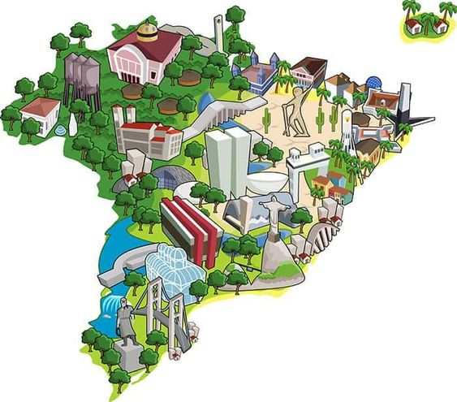
Unlocking Olist's Secrets
A data-driven journey into the Brazilian E-Commerce Marketplace
Brought to you by the Insight Igniters

Slide 2

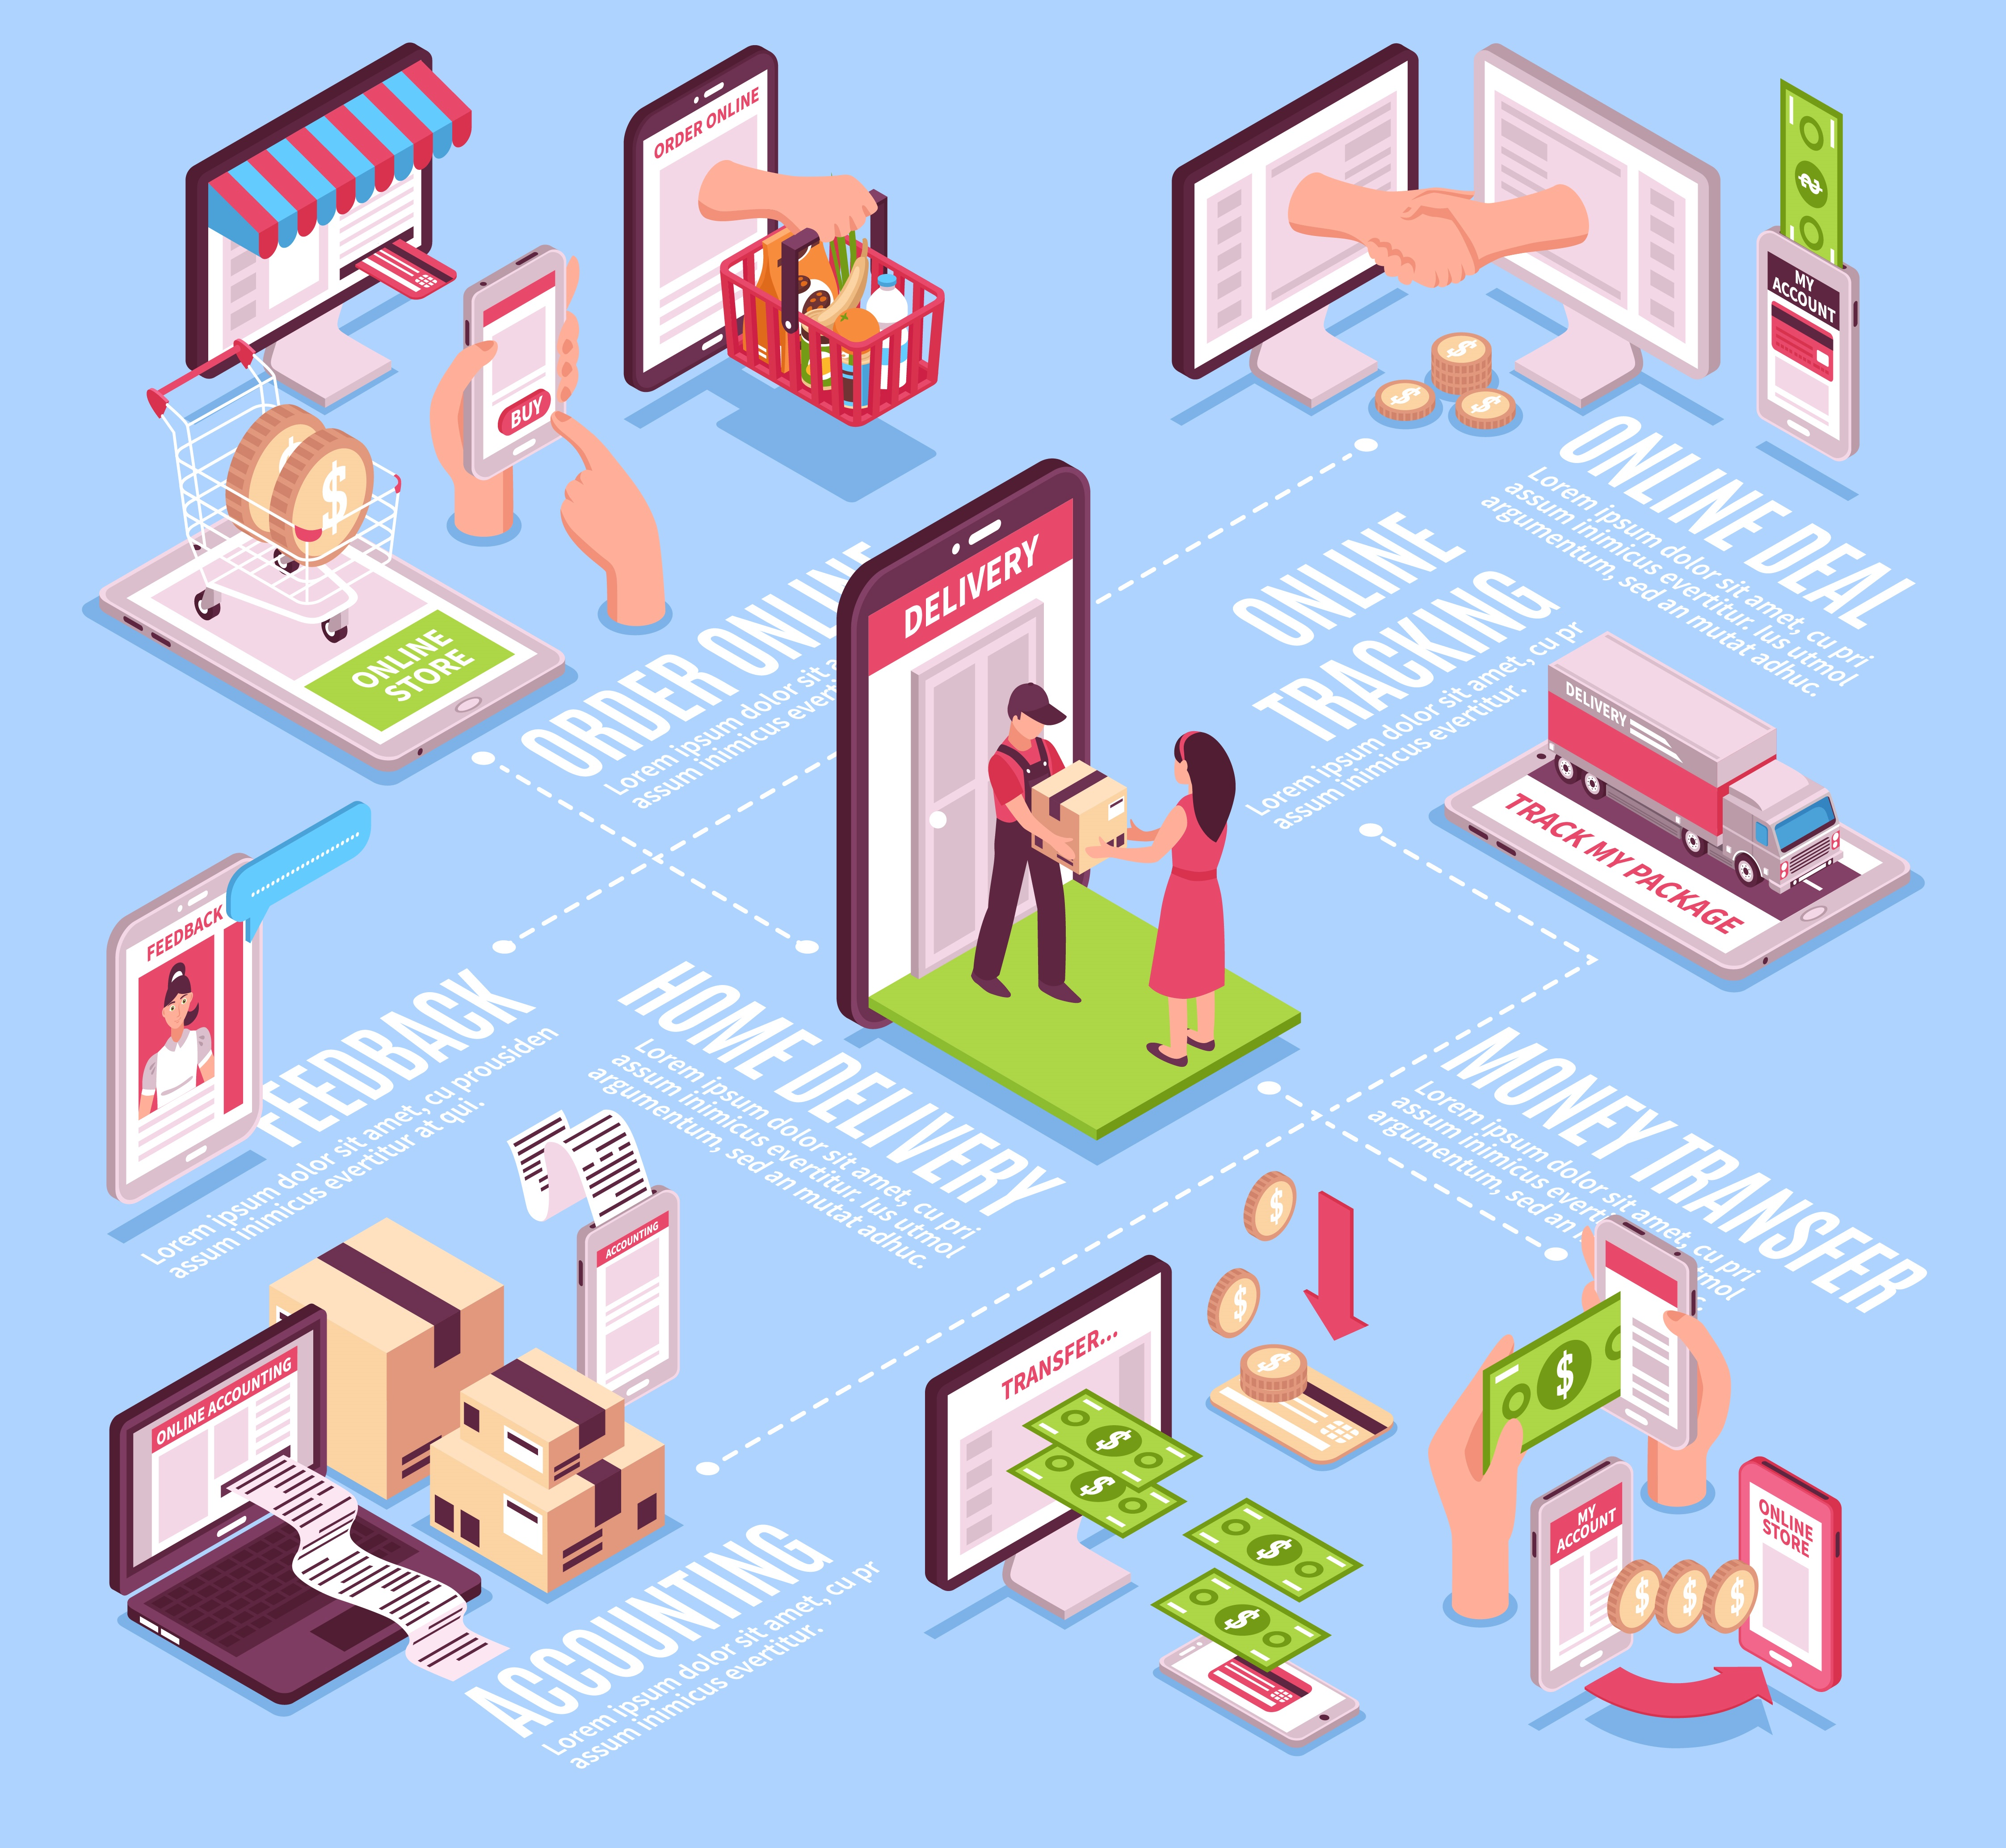
The Task
Olist Store is a prominent e-commerce platform in Brazil, connecting small businesses to customers from all across the nation.
By the end of 2018, Olist closed 4 rounds of funding and would be valued at USD100mio at its next round of funding in Oct 2019*. In a bid to take their business to the next level, Olist released a dataset of orders into the public domain, inviting interested parties to dive into the data and come up with insights and recommendations to help grow their business.
The Insight Igniters, newly minted Junior Data Engineers, took up the challenge, and this is our work.
*Data from Tracxn
Image by macrovector on Freepik

Slide 3








The Approach
Azure Data Lake Storage
Clean & Transform
Data Visualisation
Azure PostgreSQL DB
4. Analyses & Visualisation
3. Loading into DB
Data loaded into Azure DB
2. Cleaning & Transformation
EDA
Prepare data for analyses
1. Data Ingestion:
Olist dataset of 9 .csv files
Brazilian CEP data, public holiday data

Slide 4
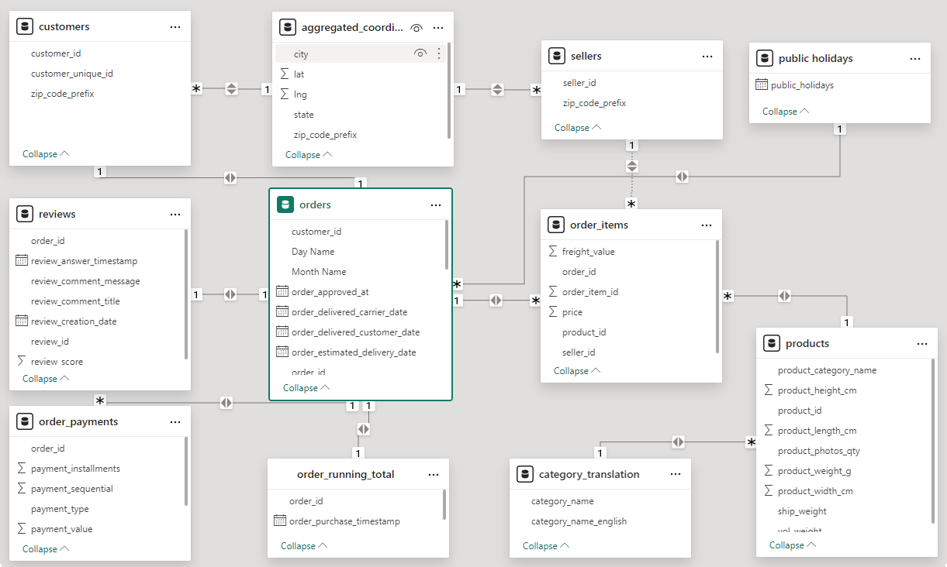
Data Model

Slide 5
Challenges | Solutions
Duplicates, missing values, malformed strings | Drop, impute, keep null
Transformation | Date time values, date maths
Geolocation dataset contained badly formed names of cities | Reference other sources
Obfuscated data meant imprecise locations, unknown products | Work with available information

Slide 6
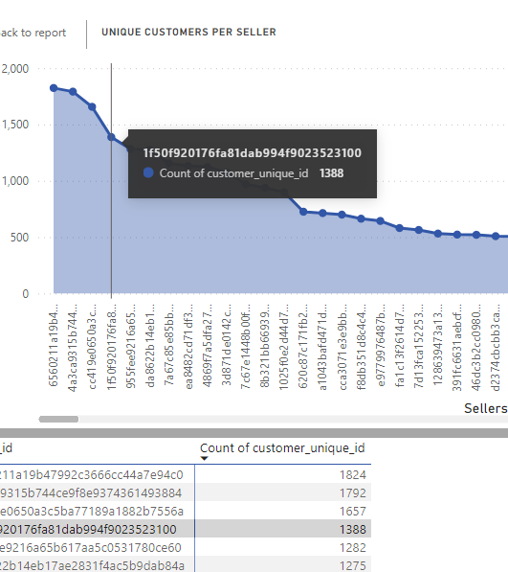
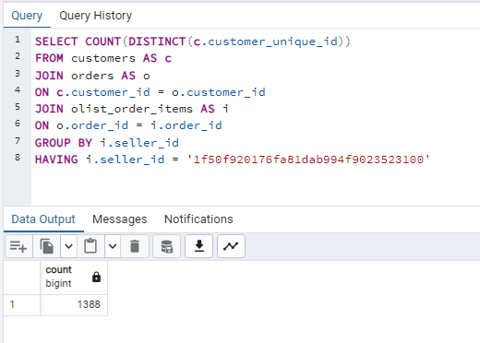
Tests & Validations

Slide 7

The Outcome
Learnings:
Brazilian postal code (CEP)
Brazilian demographics
Insights into purchasing habits
Technical Lessons:
Cleaning and transformation
Power of python and SQL
Power of data engineers (with great power...) [understand and respect the data]

Slide 8
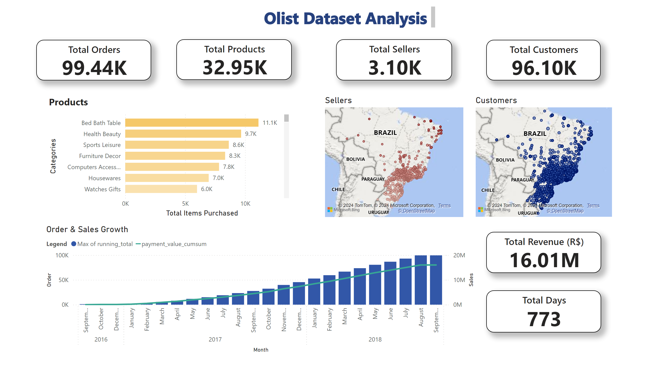
Overview

Slide 9
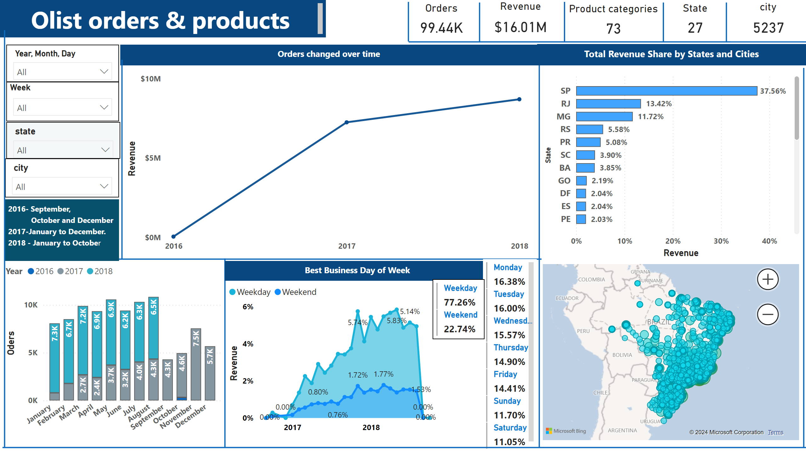
Abhi Page_2

Slide 10
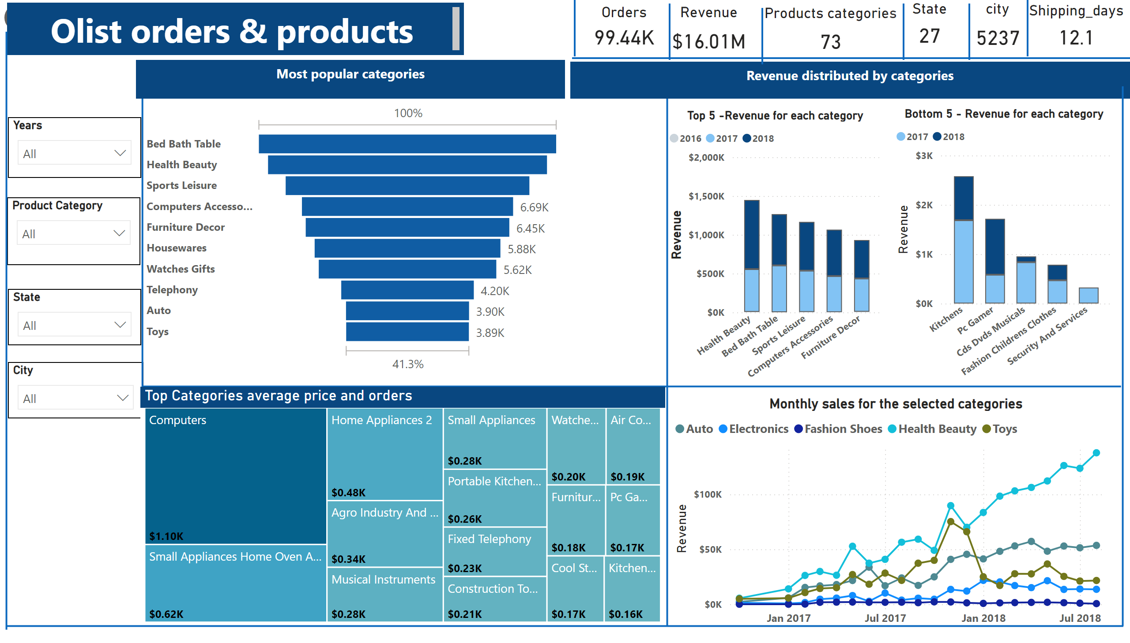
Abhi Page_1

Slide 11
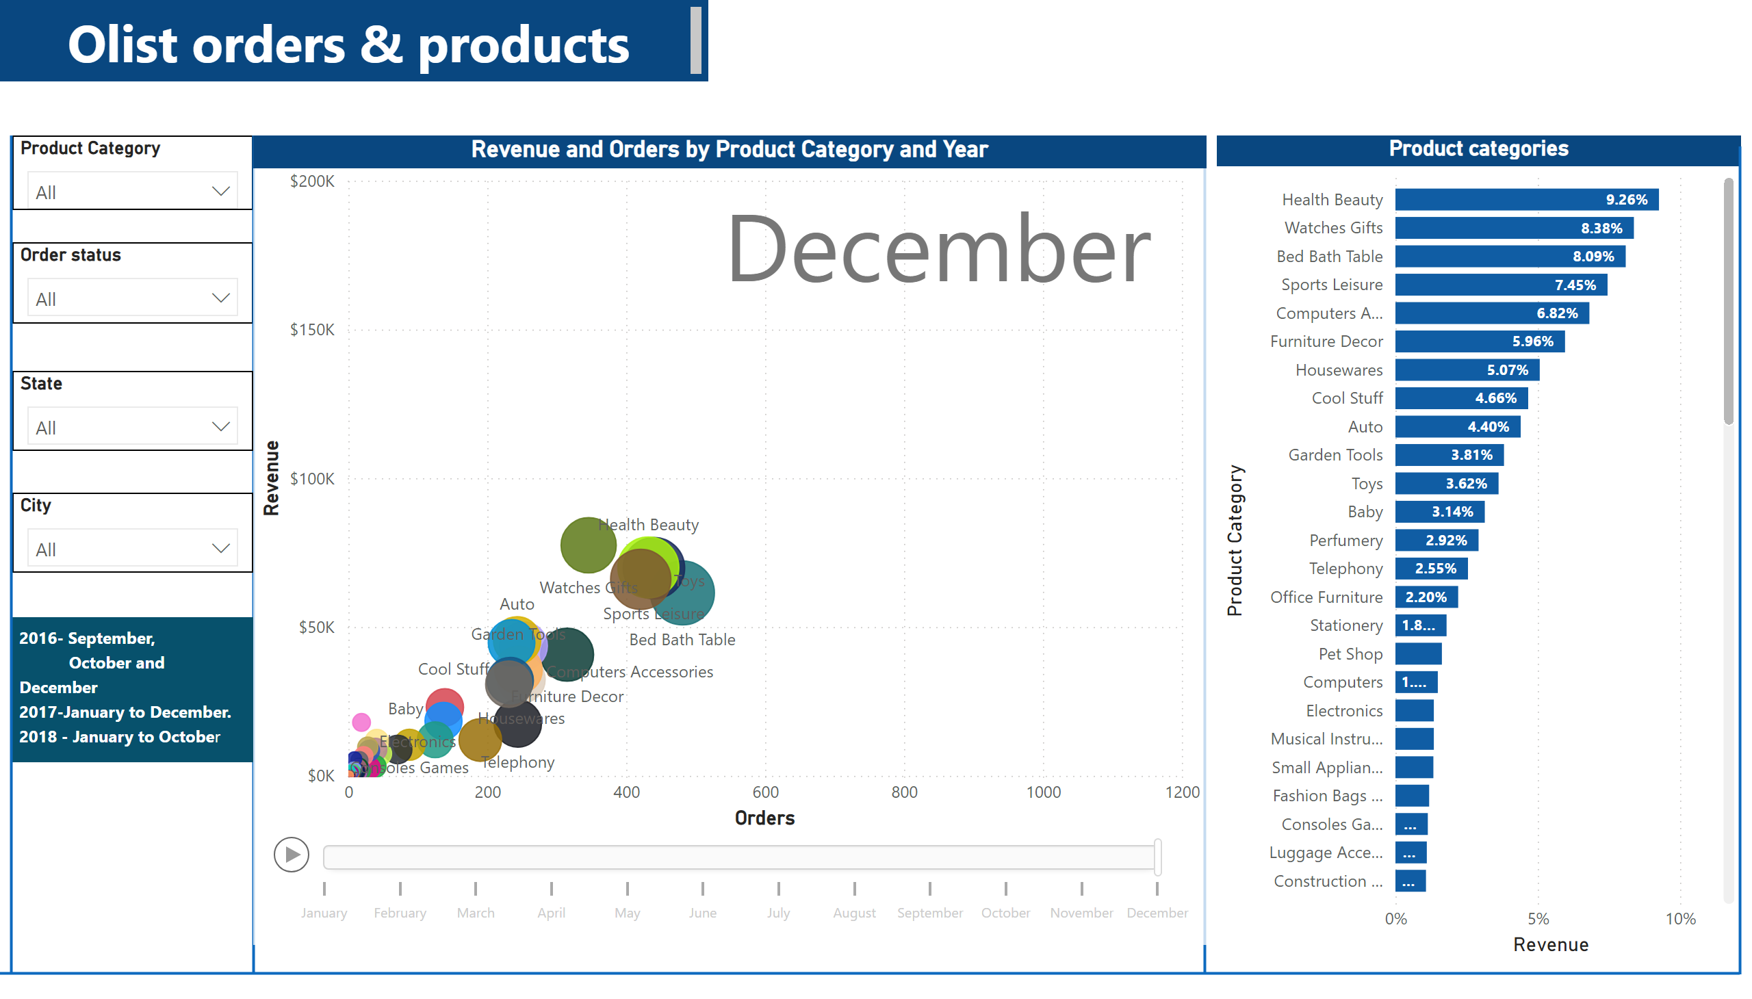
Abhi Page_3

Slide 12
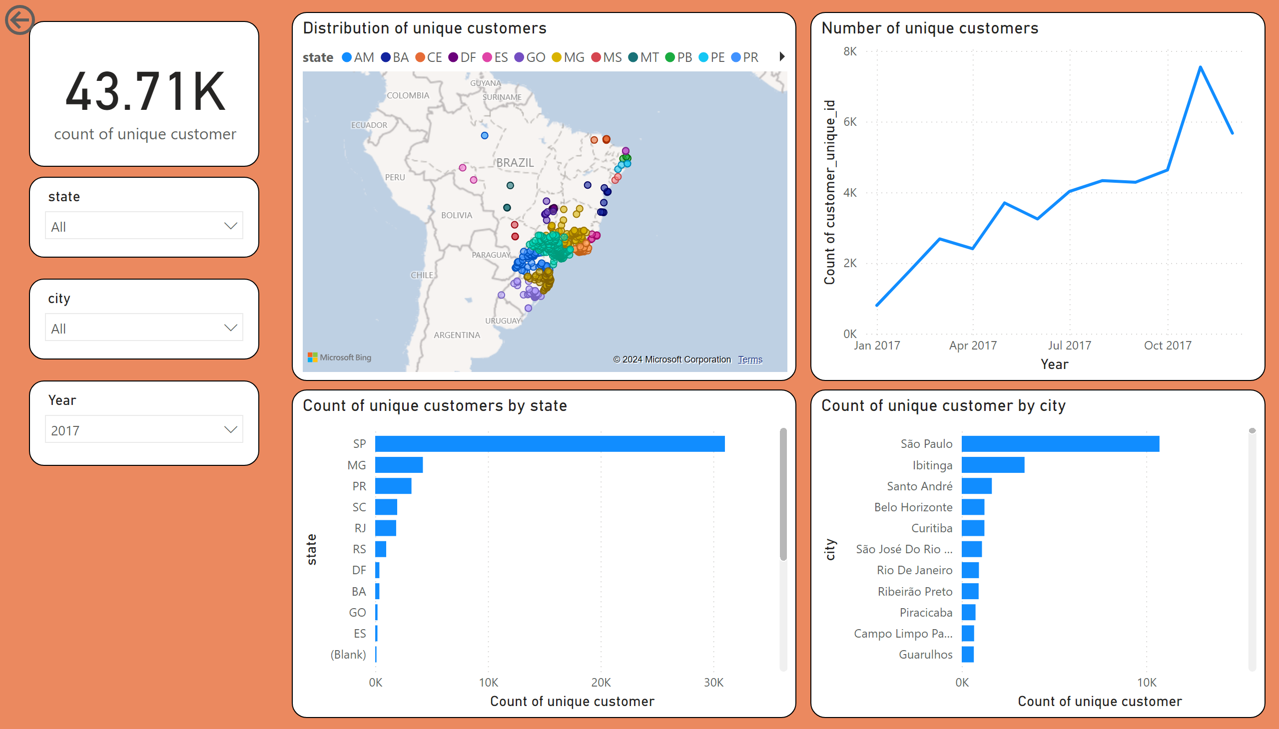
Pg 1 Customer demographics

Slide 13
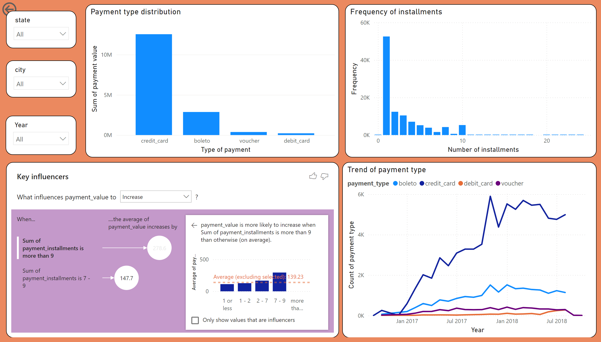
Pg 2 Customer behaviour insights

Slide 14
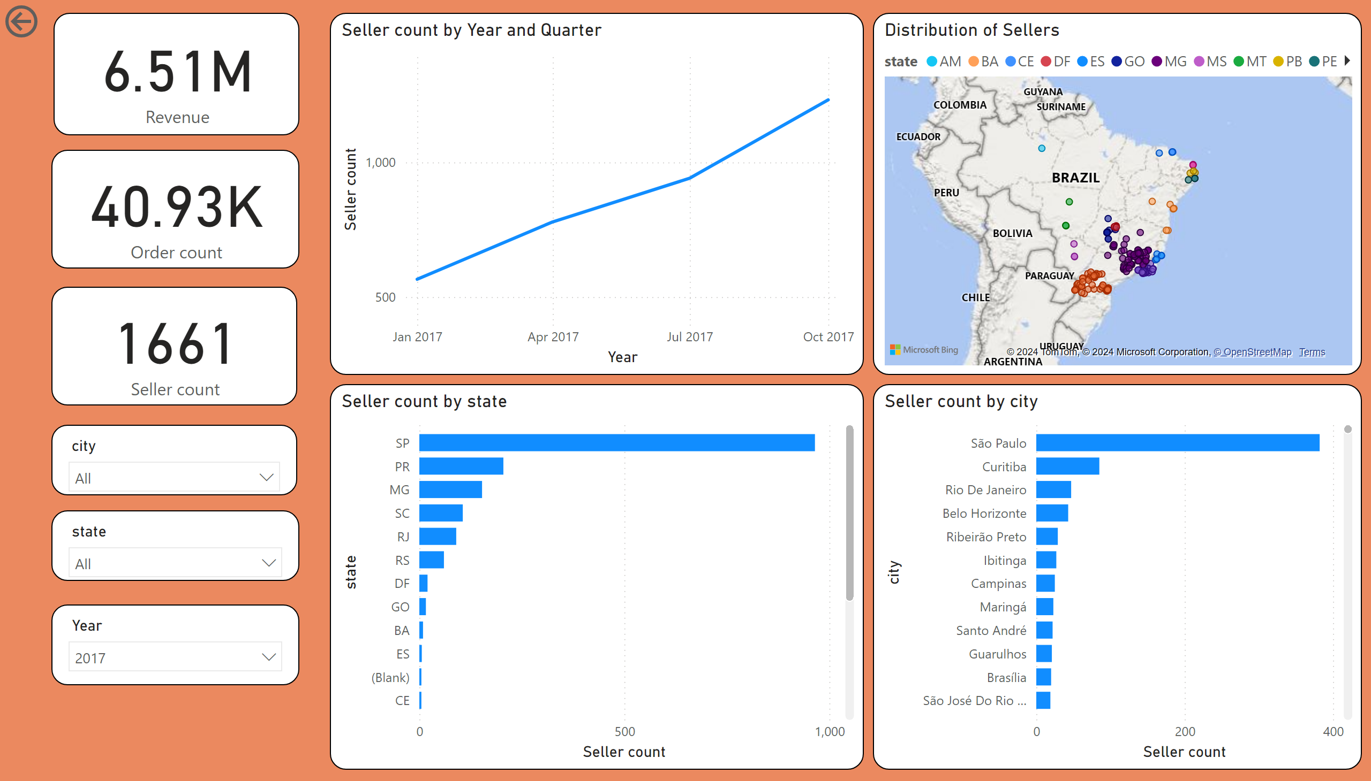
Pg 3 Seller trends

Slide 15
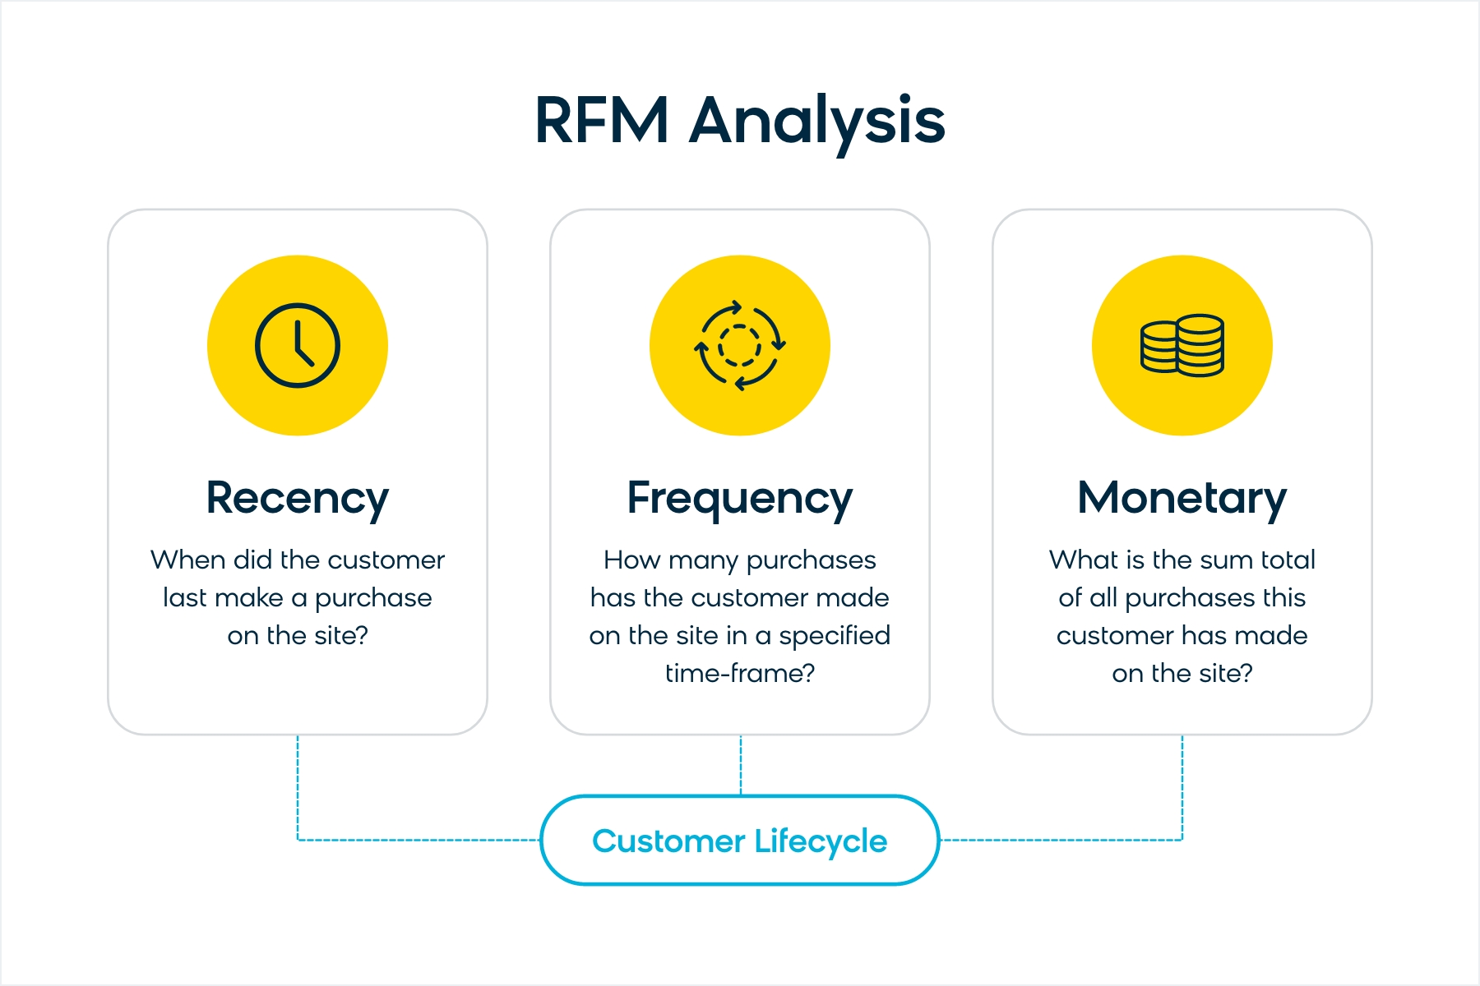
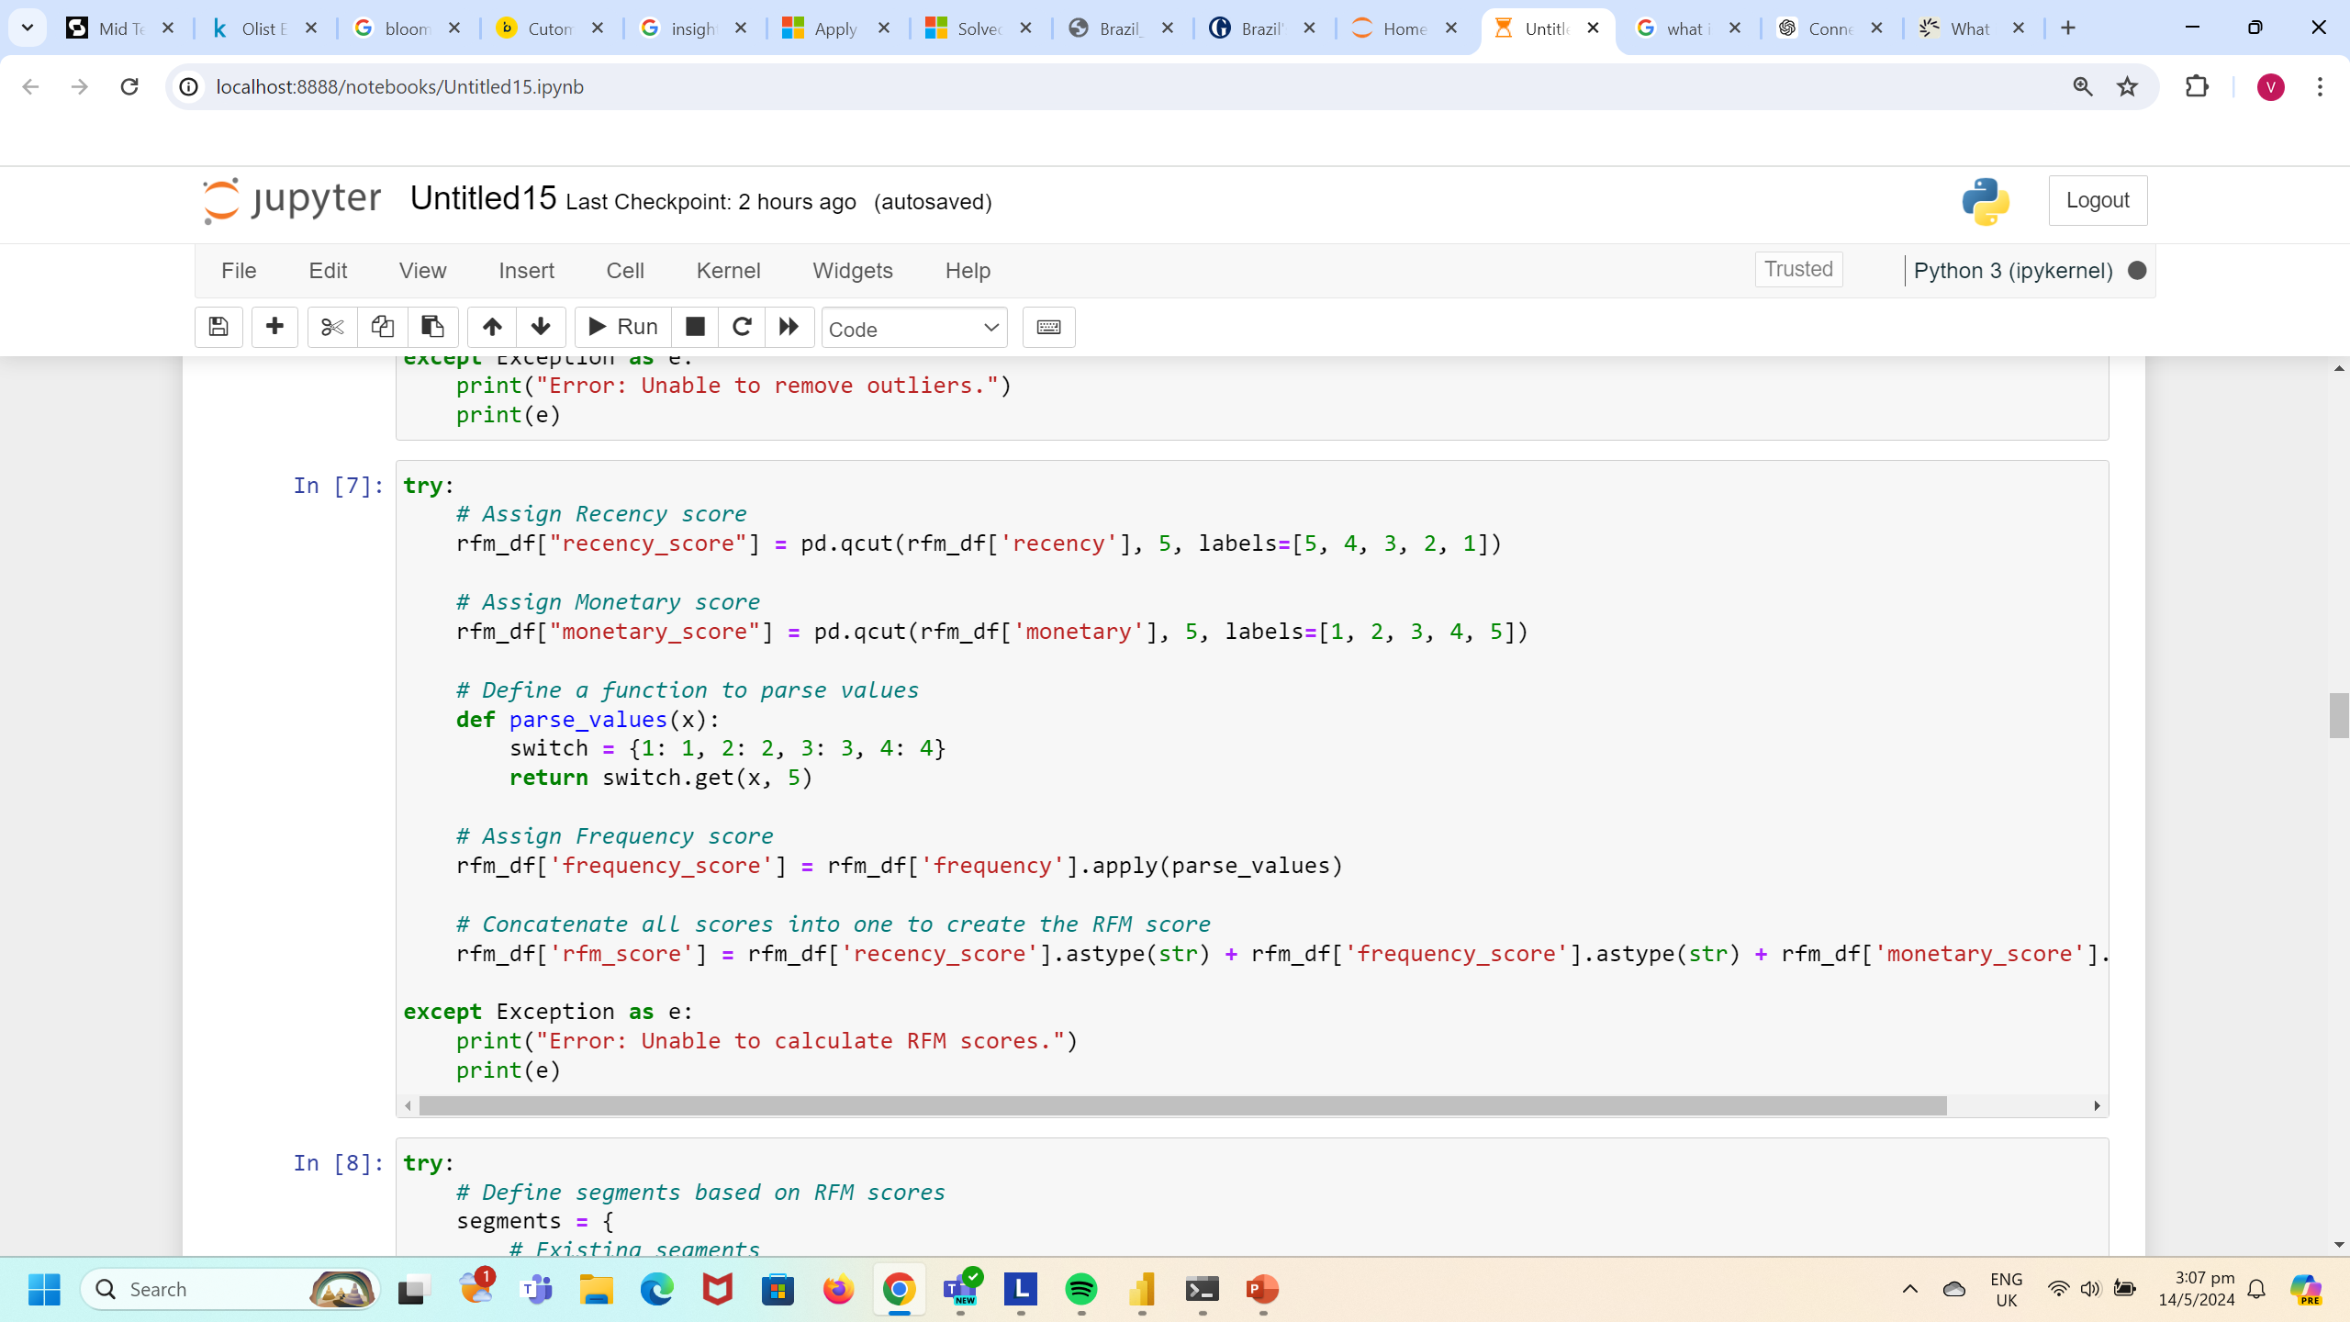
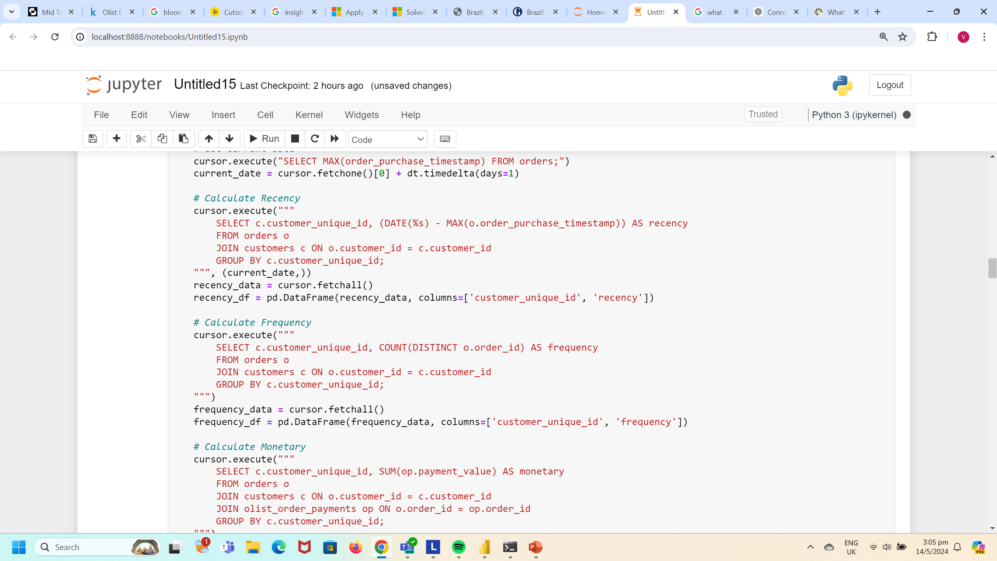
Targeted Marketing

Slide 16
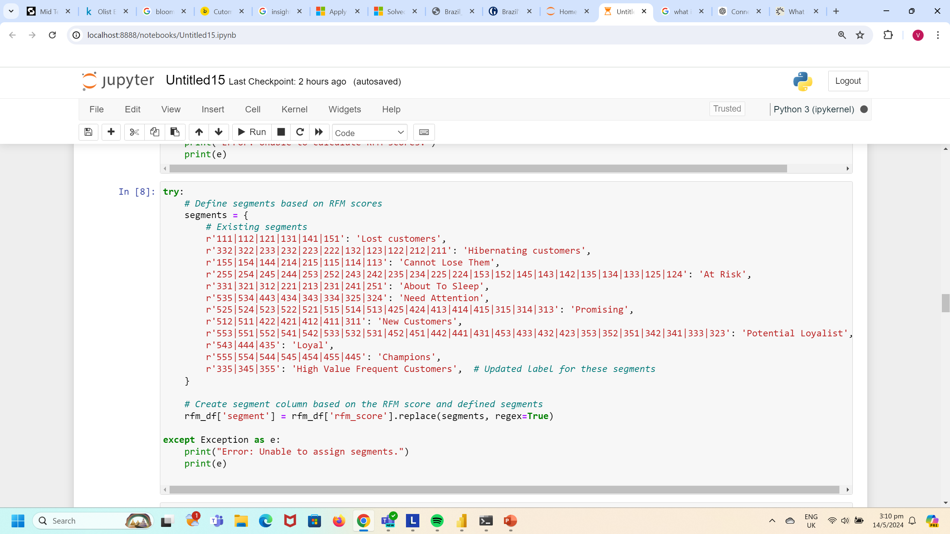
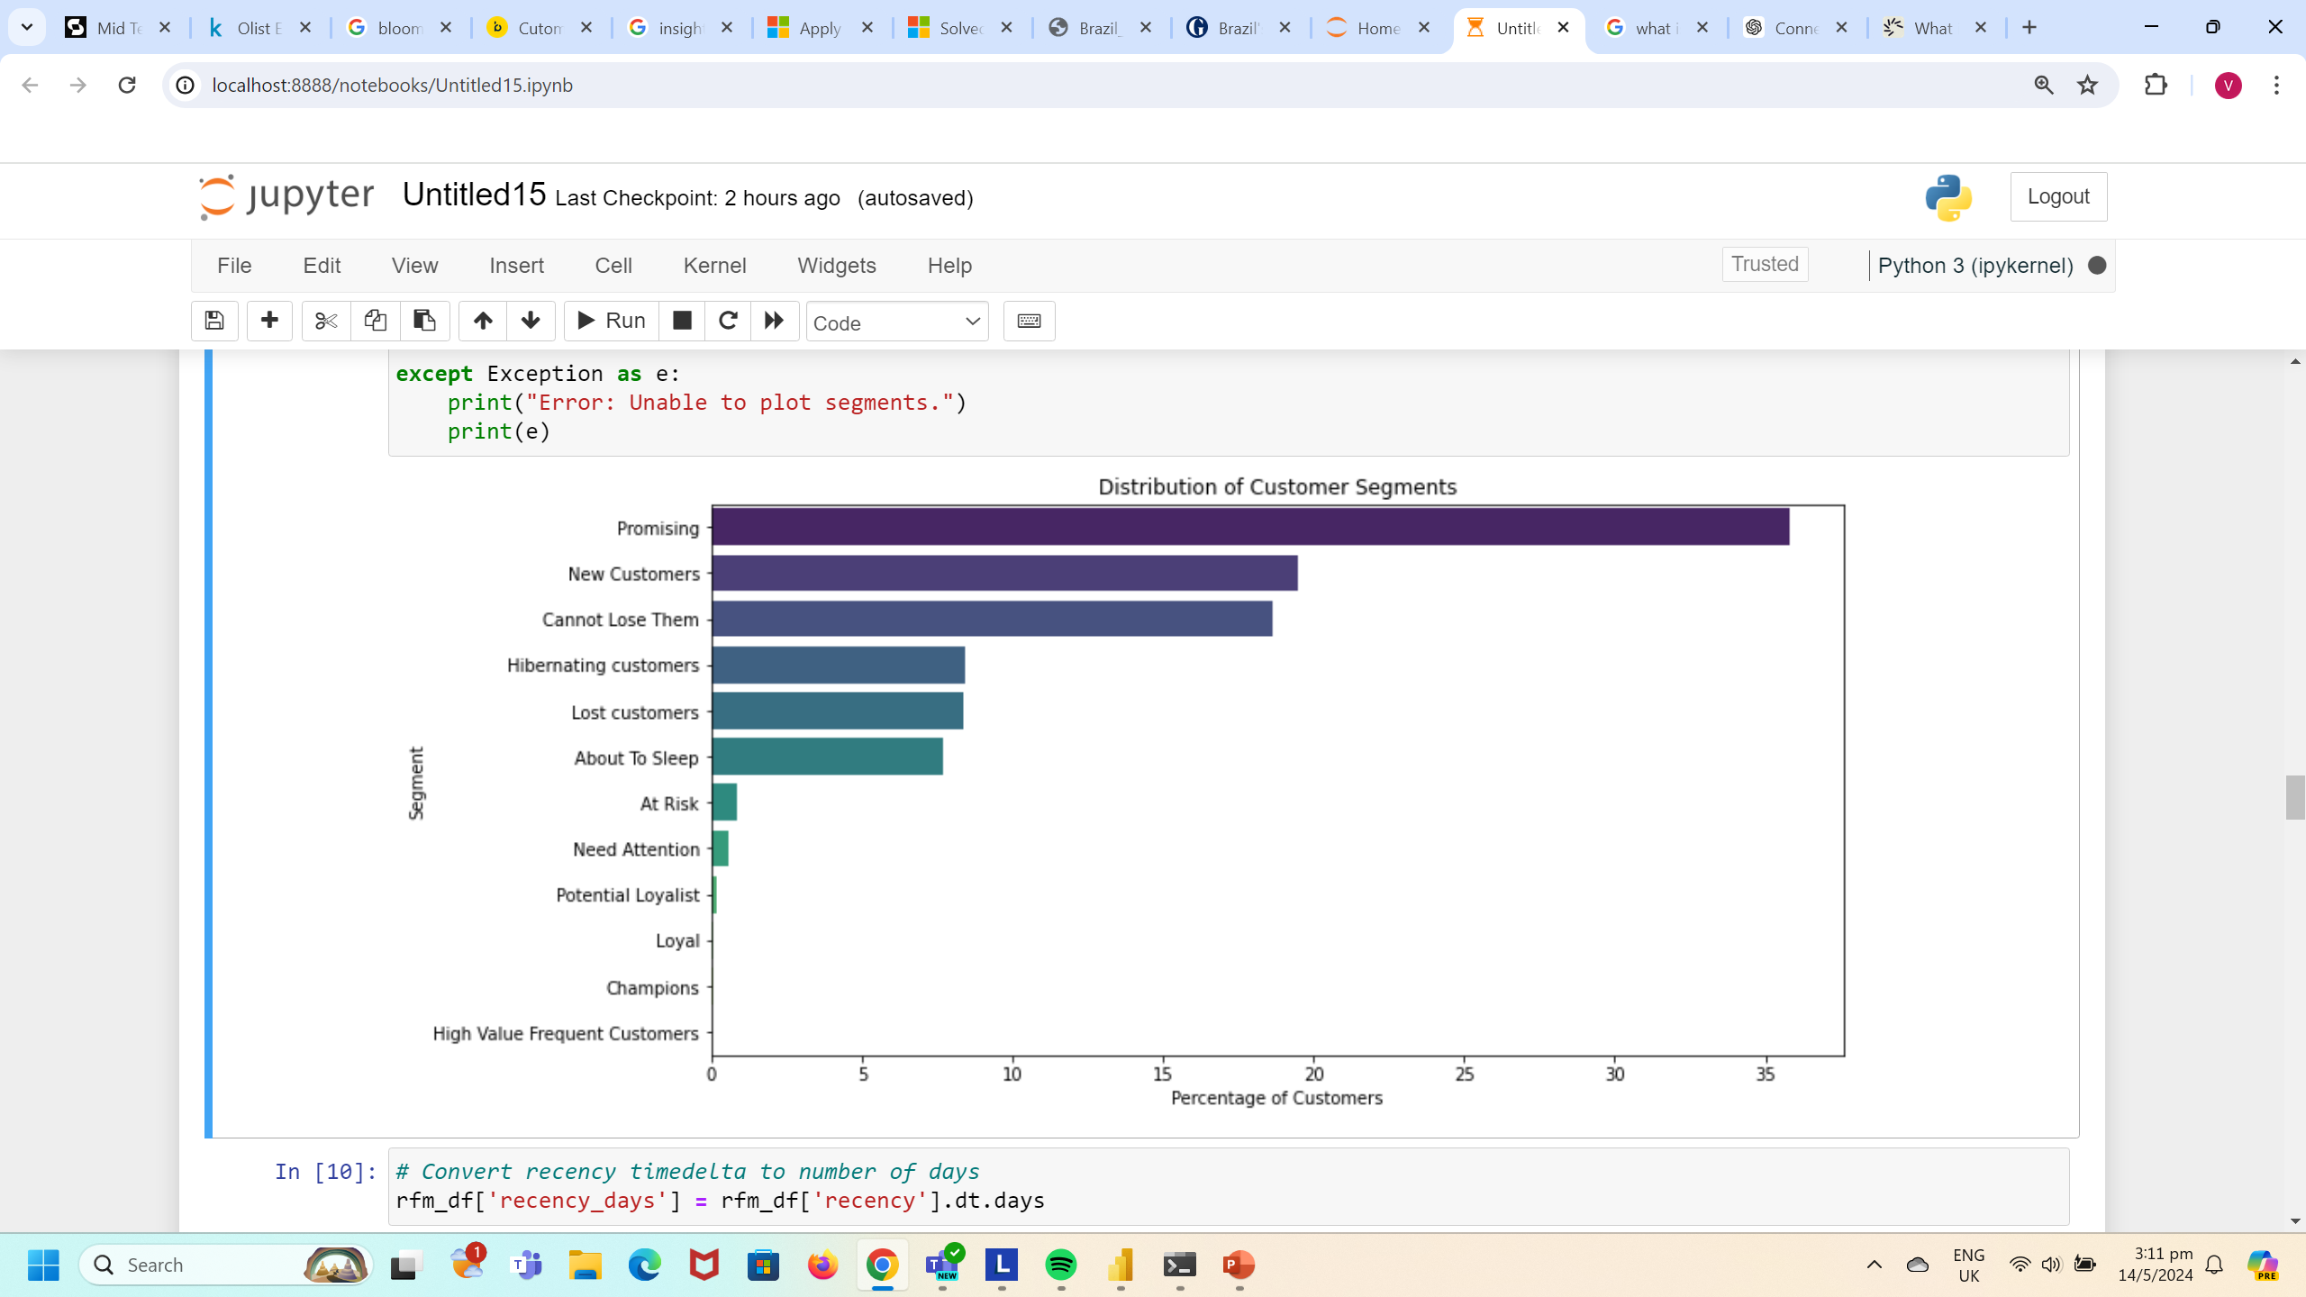
Increase the effectiveness of email marketing campaigns: Build an automated campaign with messages tailored to each segment.
Increase loyalty and user engagement: Follow up with recent customers or new customers with timely promotions and educational content likely to increase their engagement with your brand.
Decrease churn: Send personalized messages, offer repeat purchases at a discount

Slide 17
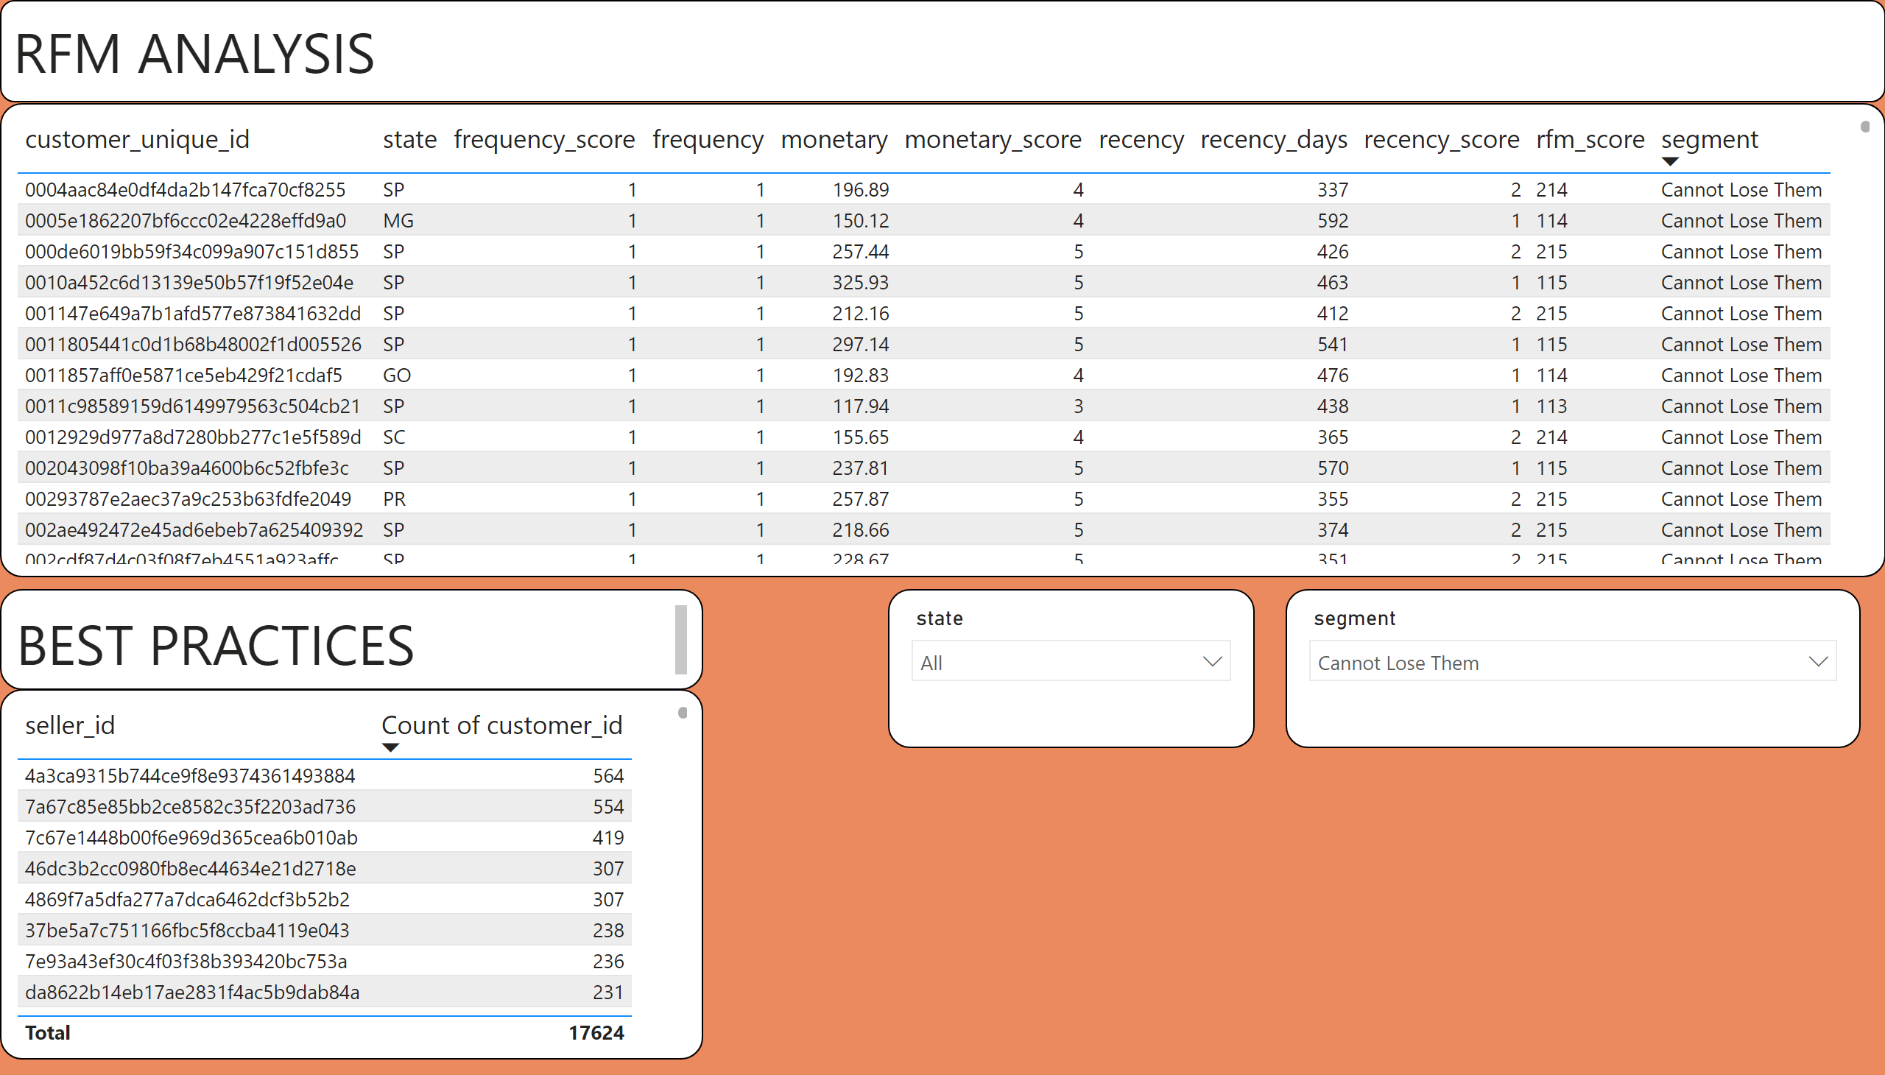
Pg 5 Seller insights

Slide 18

Customer Review Score Analysis

Slide 19
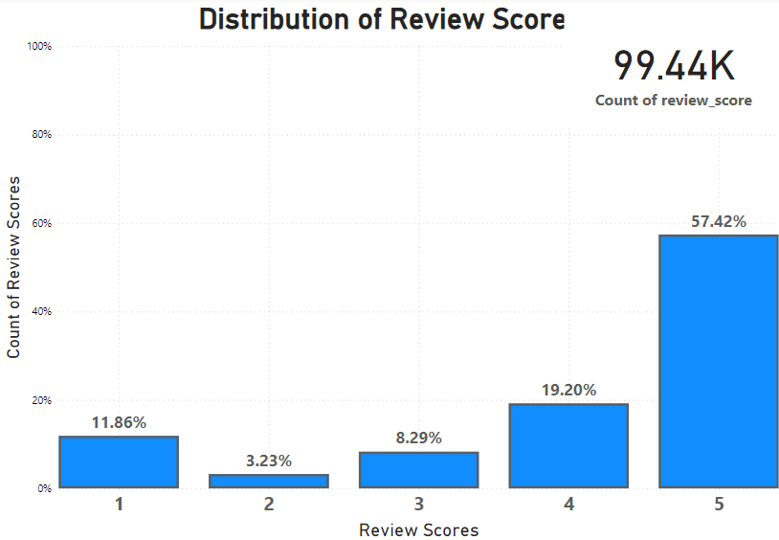

Slide 20
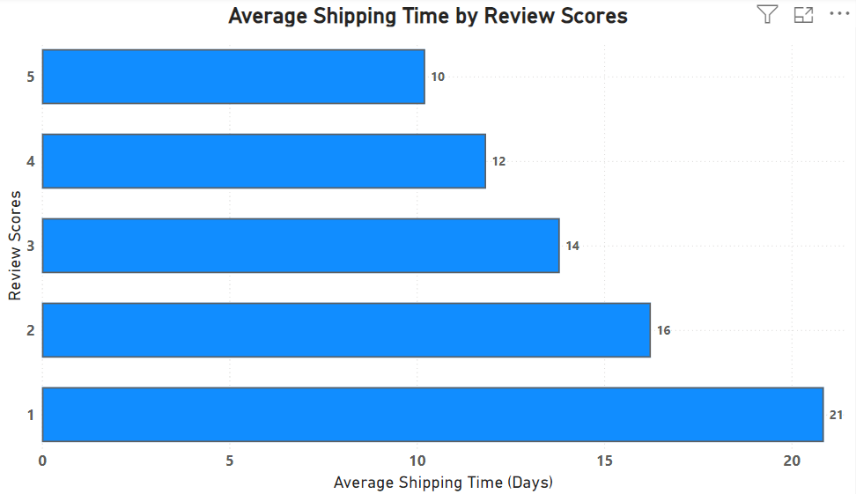

Slide 21

Rating Prediction
Use SVD model from Surprise library to predict reviews
Predicted ratings are generated for each user-item pair
Recommend items based on top predicted ratings

Slide 22
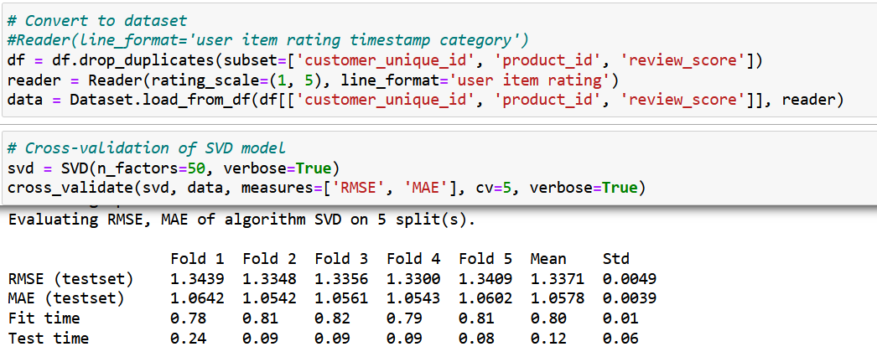
Rating Prediction
Error terms are indicative of performance

Slide 23
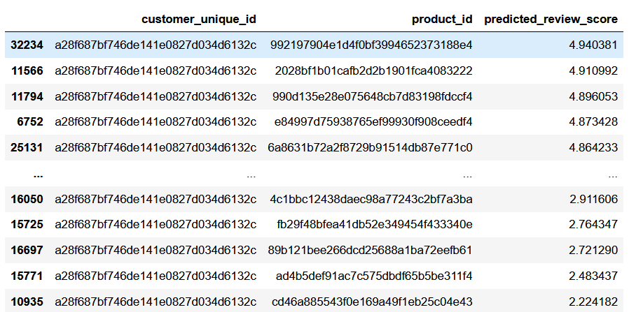
Rating Prediction
Recommend items based on top predicted ratings

Slide 24

Data issues
Reviews reference orders, not the product
Reviews should be tied to products rather than orders
Prompt users for review some time after delivery instead of immediately.
Anonymised data makes segmentation difficult
Only location data for customers and sellers
Only physical dimensions for products
Not a problem with real-world data (hopefully)
Impressions data is sparse
Ideally include not only orders, but also clicks, views.

Slide 25

Key Takeaways
Products
Promote computer products. Every unit sold in the pc/computer category generates more revenue than products in any other category.
Push out promotions on a Monday when purchases are generally higher
Customer Behaviour
Promote the use of installments / BNPL (buy-now-pay-later) services.
Engage credit card companies for more joint promotions.
Sellers
Plan marketing strategies around RFM (recency, frequency, monetary value) analysis.

Slide 26
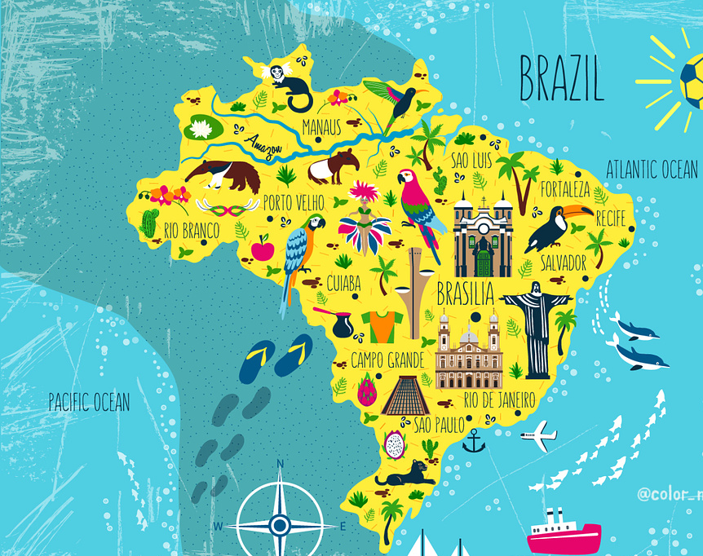
Thank you, and
tchau!

